Slide 1
Fragments
Android Applications Development

Slide 2
What is Fragment?
Android Fragment is the part of activity, it is also known as sub-activity.
There can be more than one fragment in an activity.
Fragments represent multiple screen inside one activity.
Android fragment lifecycle is affected by activity lifecycle because fragments are included in activity.
Each fragment has its own life cycle methods that is affected by activity life cycle because fragments are embedded in activity.
The FragmentManager class is responsible to make interaction between fragment objects.
Introduced in Honeycomb API 11.

Slide 3
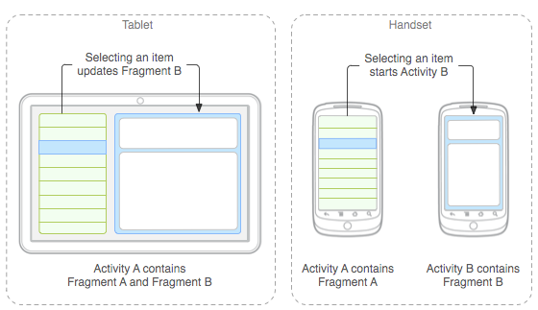
What is Fragment?

Slide 4
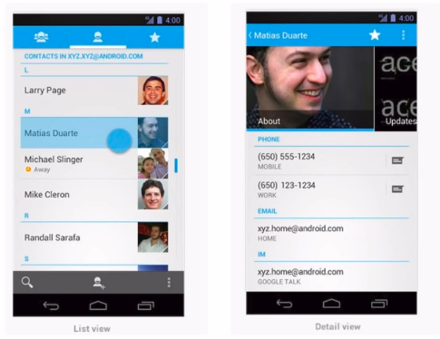
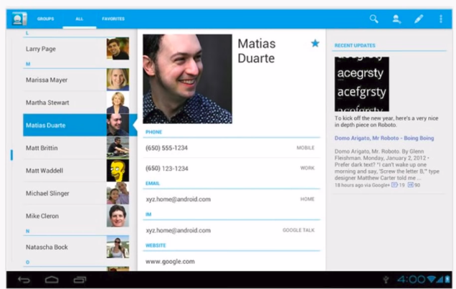
Example
Fragments inside single activity
Multiple Activities. ( Traditional Way)
Model Way

Slide 5
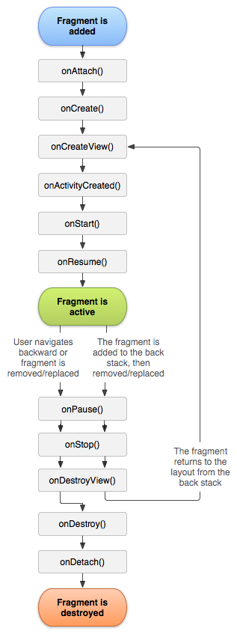
Fragment Lifecycle

Slide 6
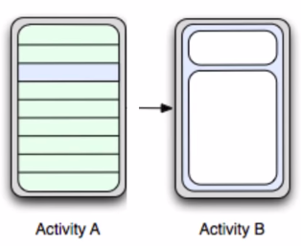
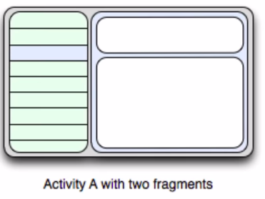
Why Fragments?
Combine several fragments in a single Activity.
Reuse the same Fragment across several Activities.
Make better use of larger screen space in tablets.
Support different layouts on potrait and landscapes modes.

Slide 7
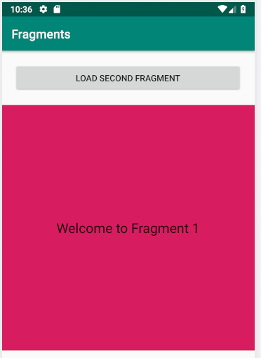
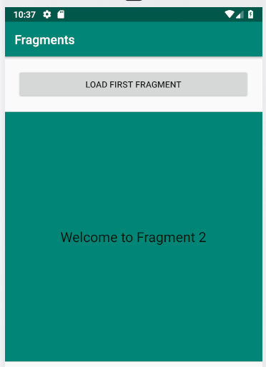
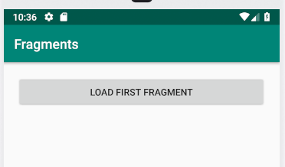
Example

Slide 8
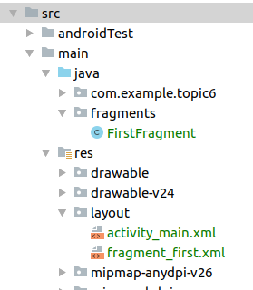
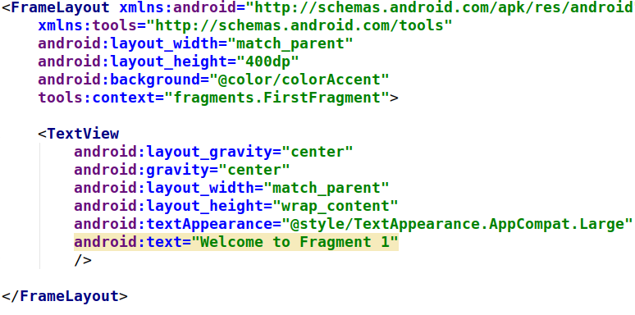
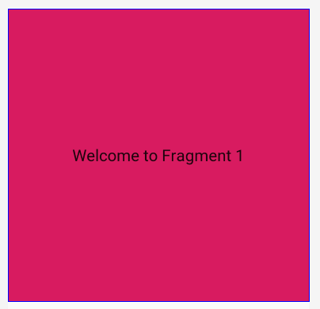
1. Create a namespace named fragment and add new fragment

Slide 9
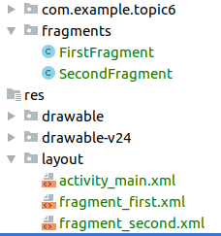
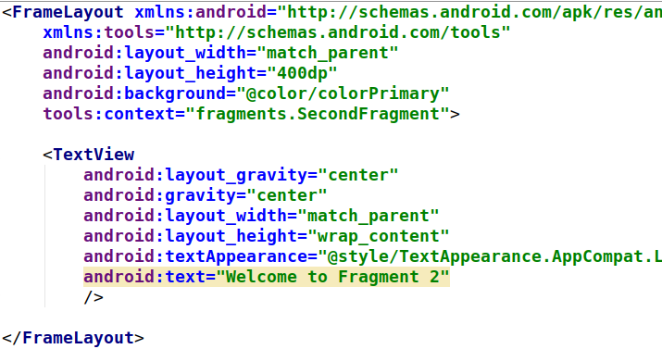
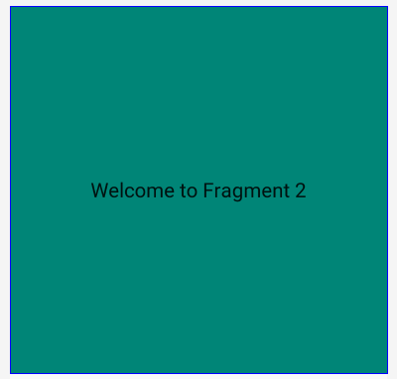
2. 2nd Fragment

Slide 10
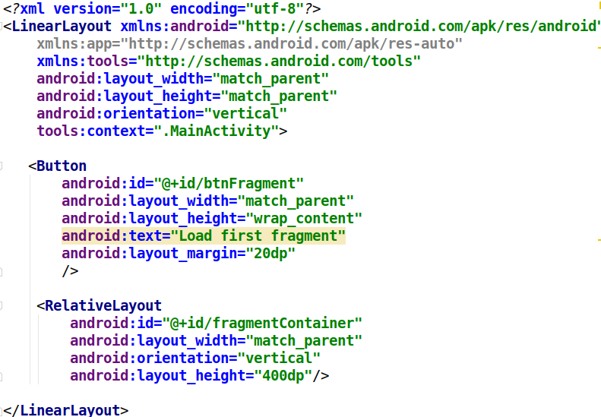
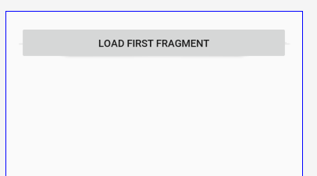
3. Main Activity XML

Slide 11
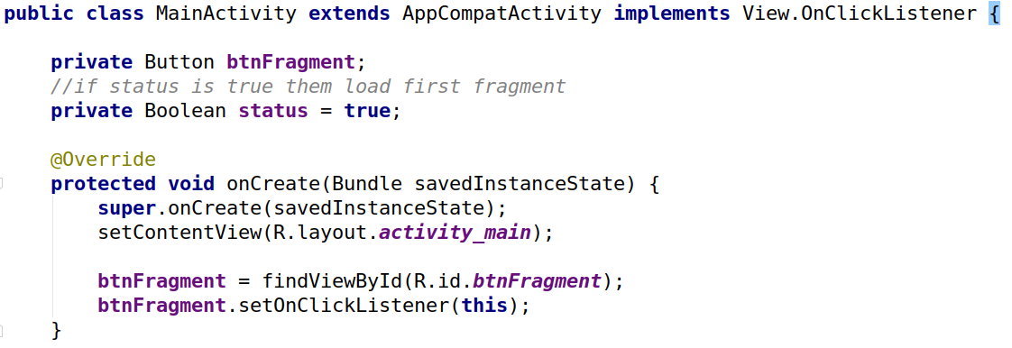
4. Java Code

Slide 12
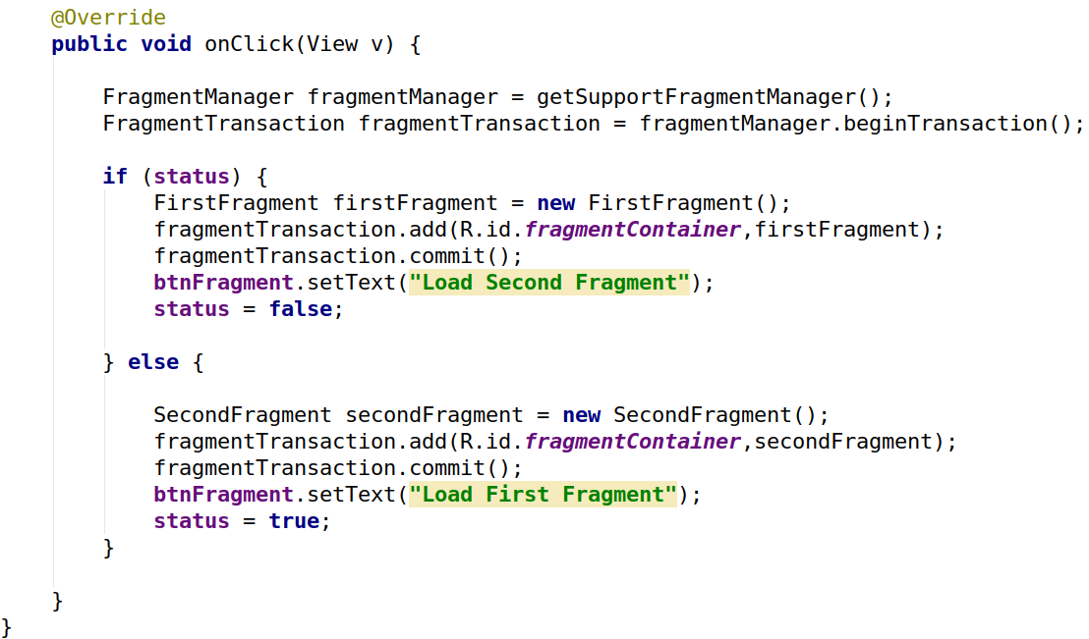
5. Java Code
Replace add with replace

Slide 13
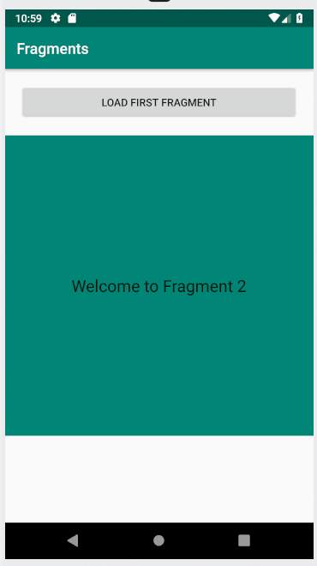
What happens when you click back button ?

Slide 14
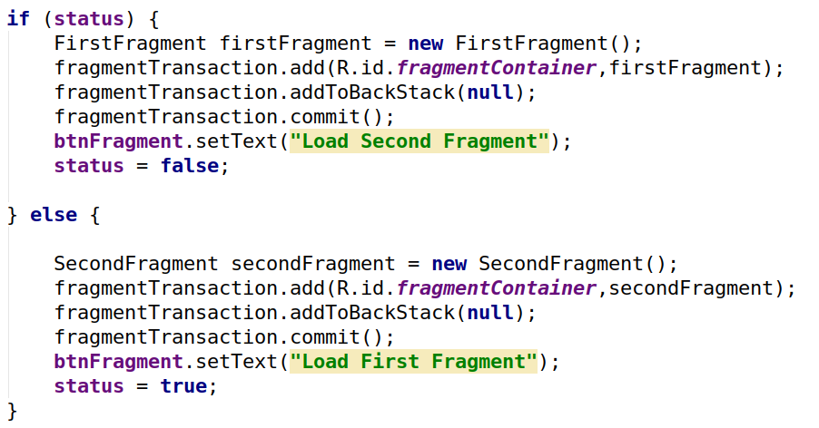
Replace add with replace

Slide 15
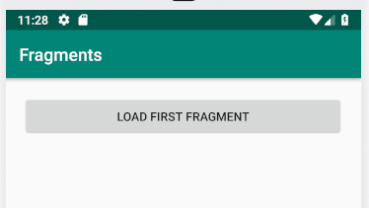
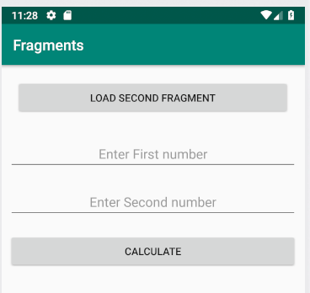
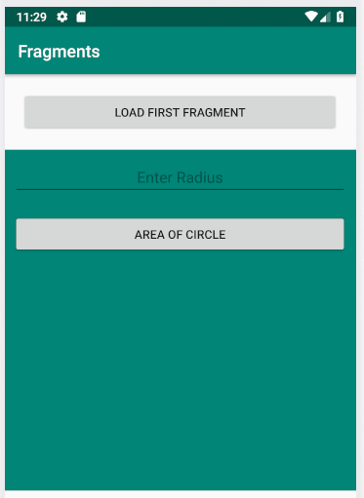
Class Exercise
Do not use the background
color in this fragment

Slide 16
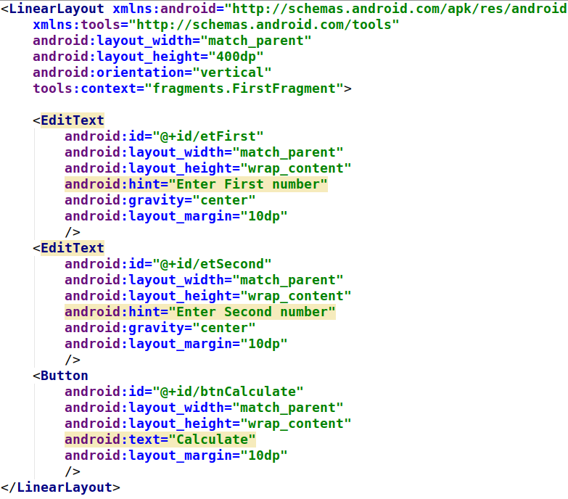
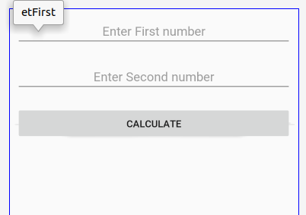
First Fragment

Slide 17
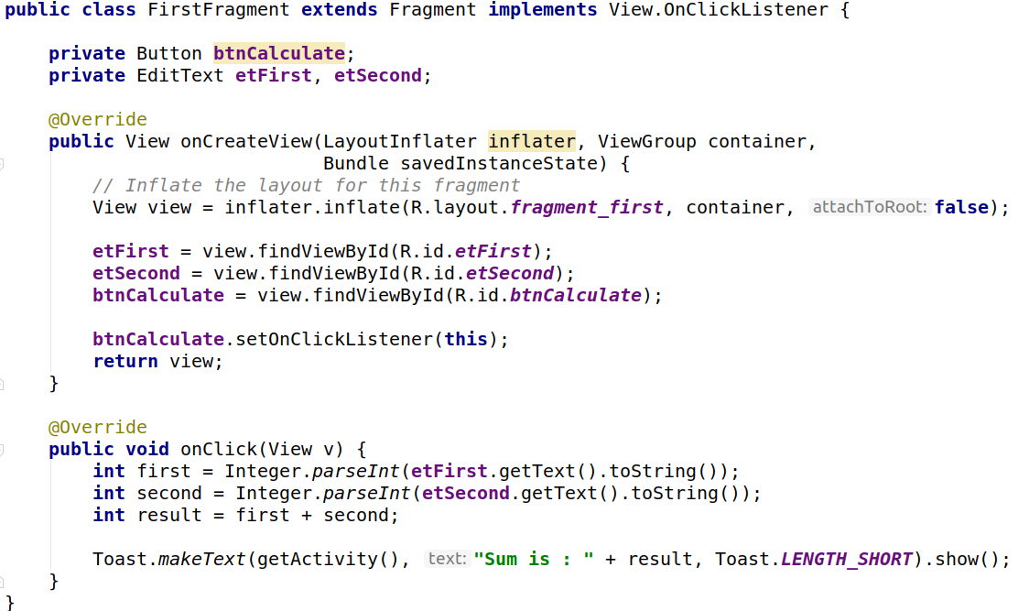

Slide 18
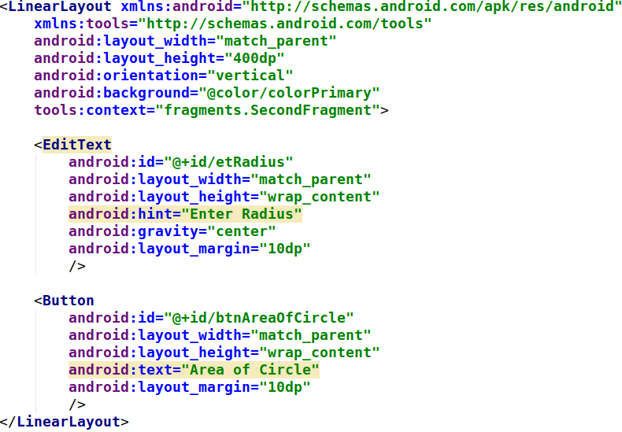
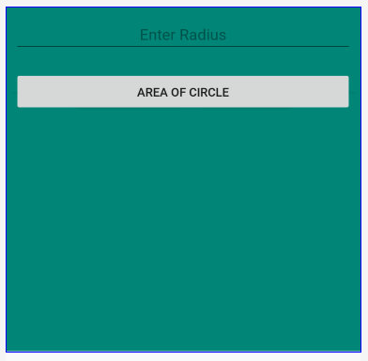
Second Fragment

Slide 19
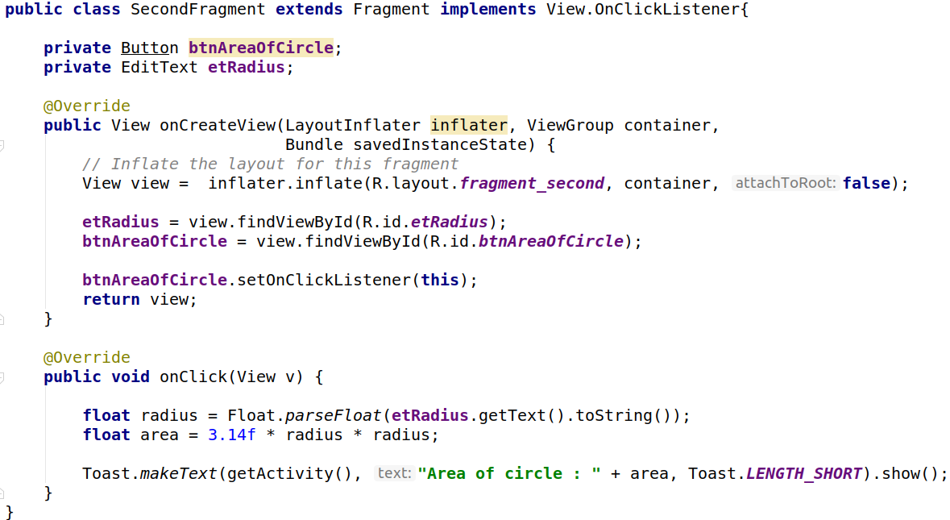

Slide 20
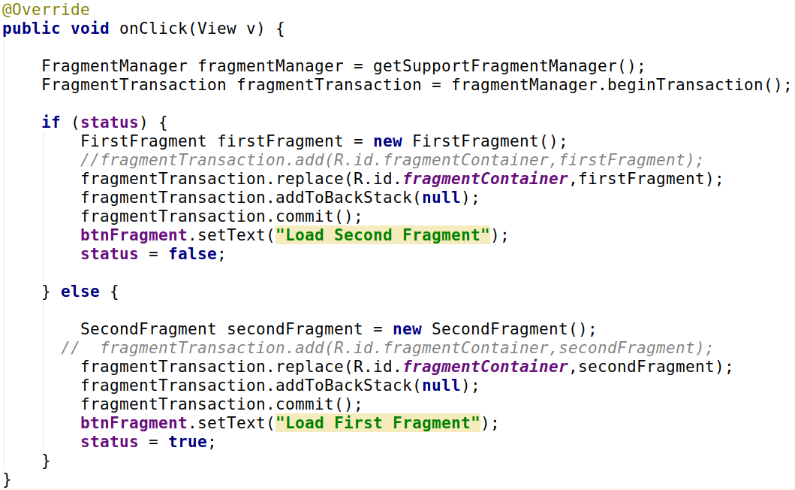
Main Activity

Slide 21
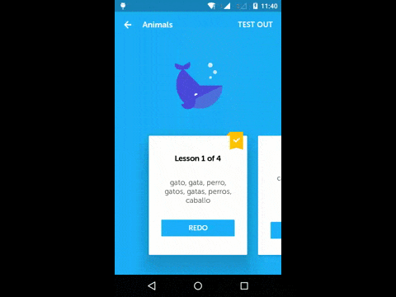
ViewPager
ViewPager is the widget that allow user to swipe left or right to see an entirely new screen.
It also has the ability to dynamically add and remove pages (or tabs) at anytime.

Slide 22
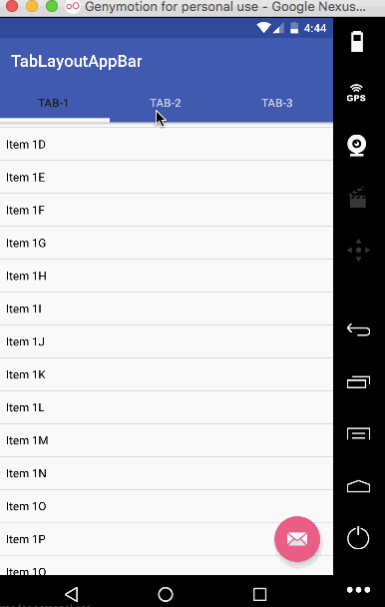
TabLayout
TabLayout provides a horizontal layout to display tabs.
TabLayout is released by Android after the deprecation of ActionBar.TabListener (API level 21).

Slide 23
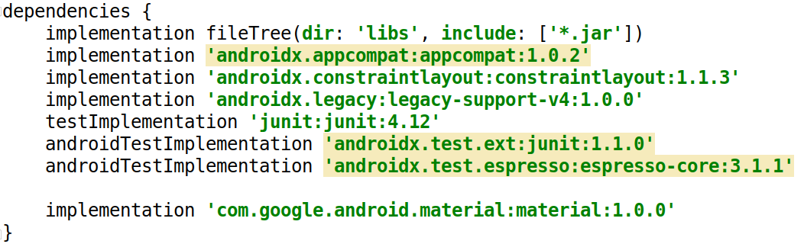
Add dependency to use TabLayout
implementation 'com.google.android.material:material:1.0.0'

Slide 24
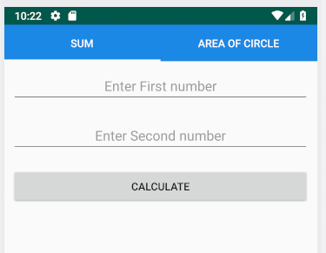
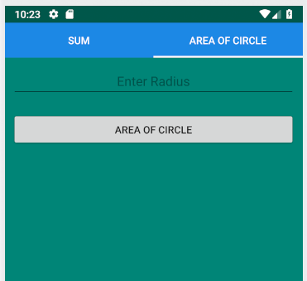
Example : using TabLayout and ViewPager
Swipe leftto open another tab

Slide 25
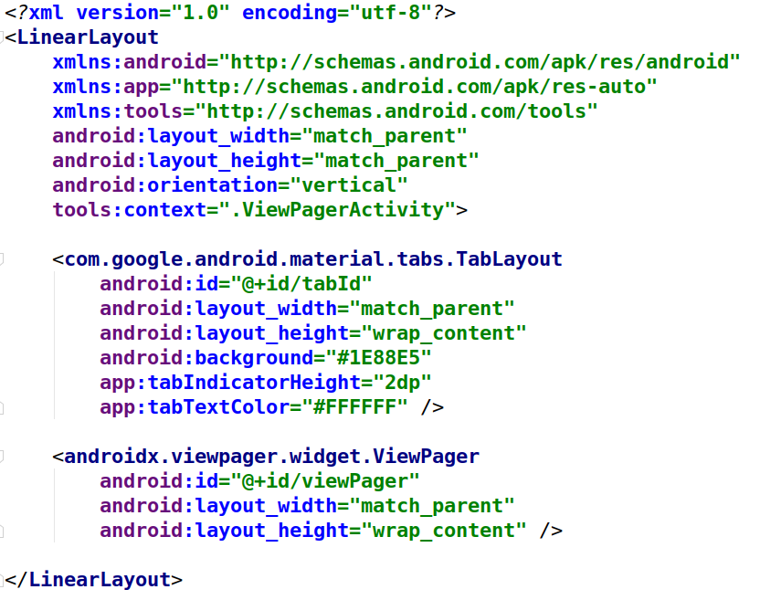
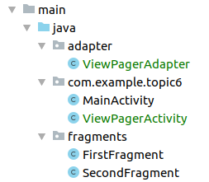
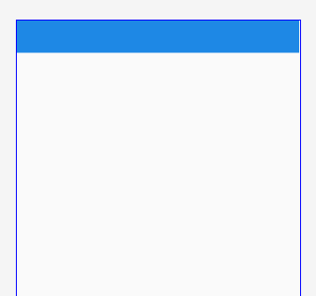
ViewPagerActivity

Slide 26
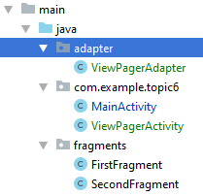
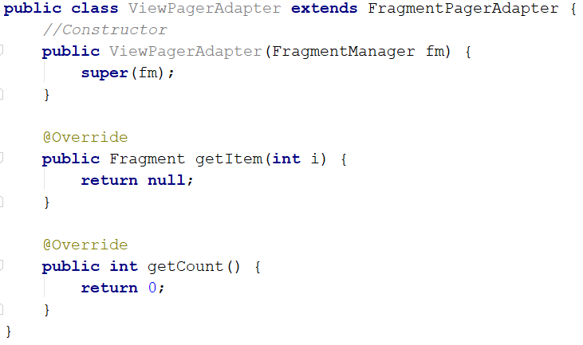
Fragment adapter

Slide 27
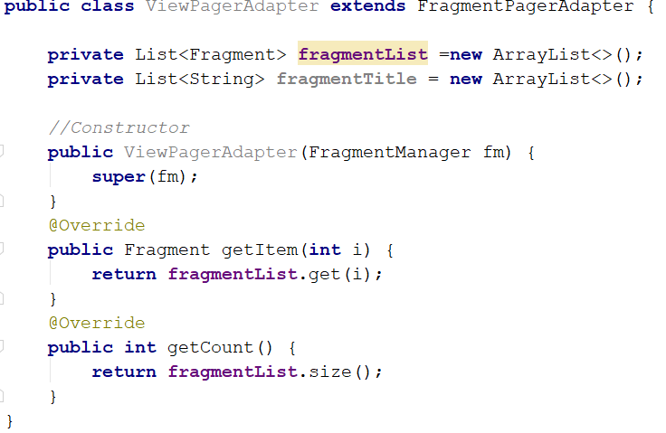
Override two methods

Slide 28
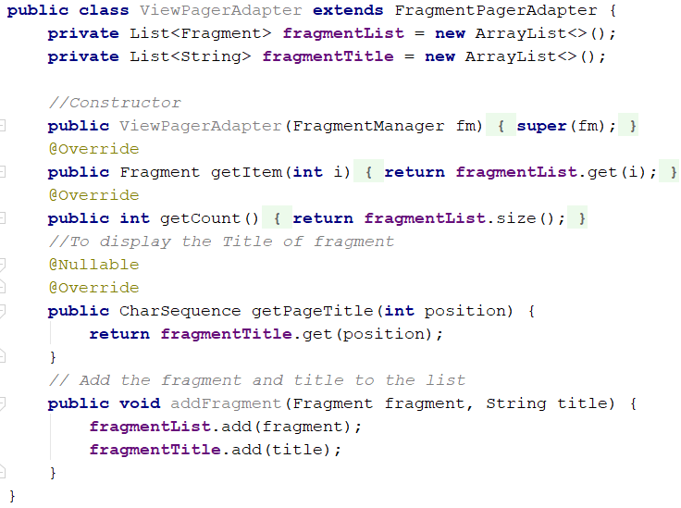
Add another method
Press crtl + o and override
getPageTitle method

Slide 29
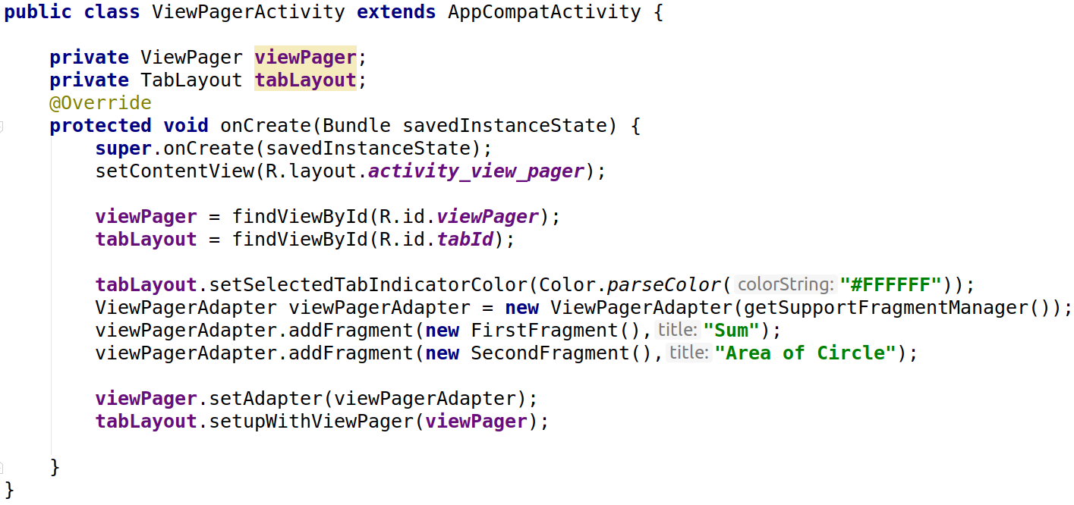
ViewPagerActivity

Slide 30
Android Menu
Menus are a common user interface component in many types of applications. To provide a familiar and consistent user experience, you should use the Menu APIs to present user actions and other options in your activities.
Beginning with Android 3.0 (API level 11), Android-powered devices are no longer required to provide a dedicated Menu button. With this change, Android apps should migrate away from a dependence on the traditional 6-item menu panel and instead provide an app bar to present common user actions.

Slide 31
Types of Menu
There are three types of menus in Android: Popup, Contextual and Options.
Each one has a specific use case and code that goes along with it.
Each menu must have an XML file related to it which defines its layout. These are the tags associated with the menu option:
<menu> - This is the container element for your menu (similar to LinearLayout)
<item> - This denotes an item and is nested inside of the menu tag. Be aware that an item element can hold a <menu> element to represent a submenu
<group> - This is used to signify a certain property or feature to a couple of menu items (I.E. state/visibility)

Slide 32
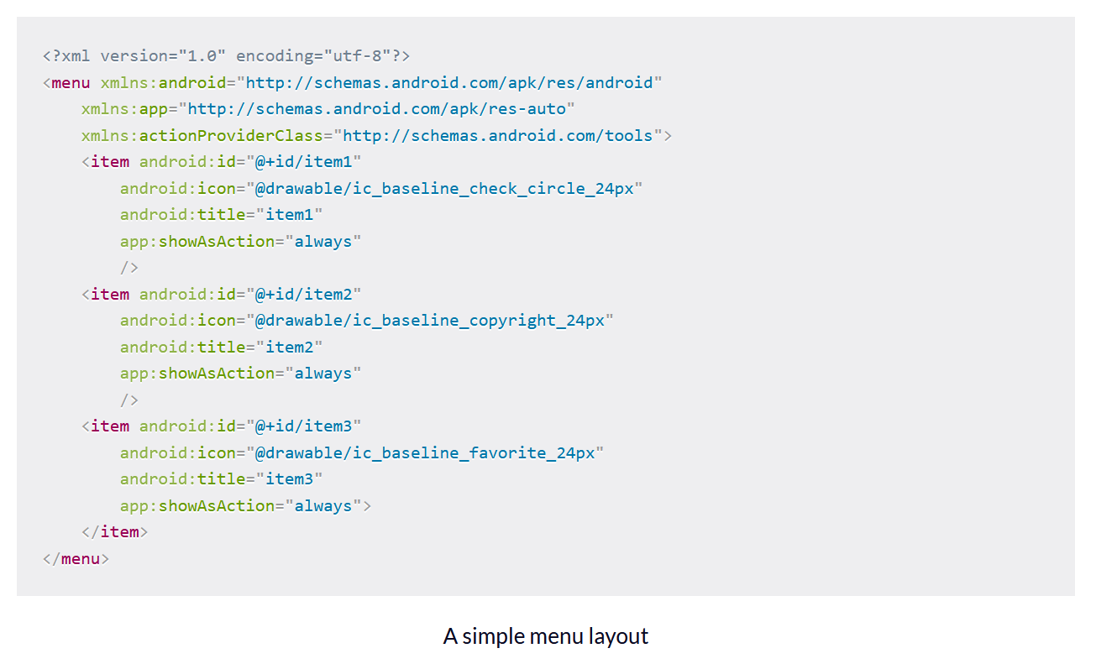
Simple Menu Layout
As shown in the code snippet right side, each menu item has various attributes associated with it.
id - This is a unique identifier for the item in the menu. You can use this to see exactly which item the user clicked
icon - If you want to show an icon associated with that menu item
title - Text that will be shown in the menu for that item
showAsAction - This attribute should only be used when using a menu in an activity that uses an application bar
android:showAsAction="always|never|ifRoom|withText|collapseActionView"

Slide 33
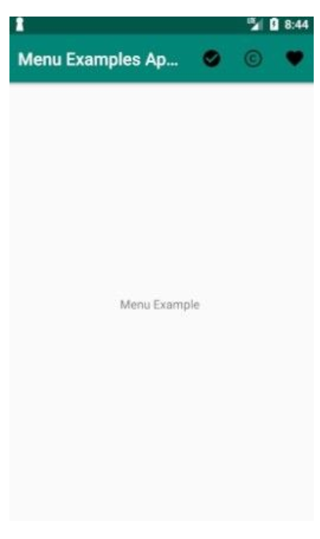
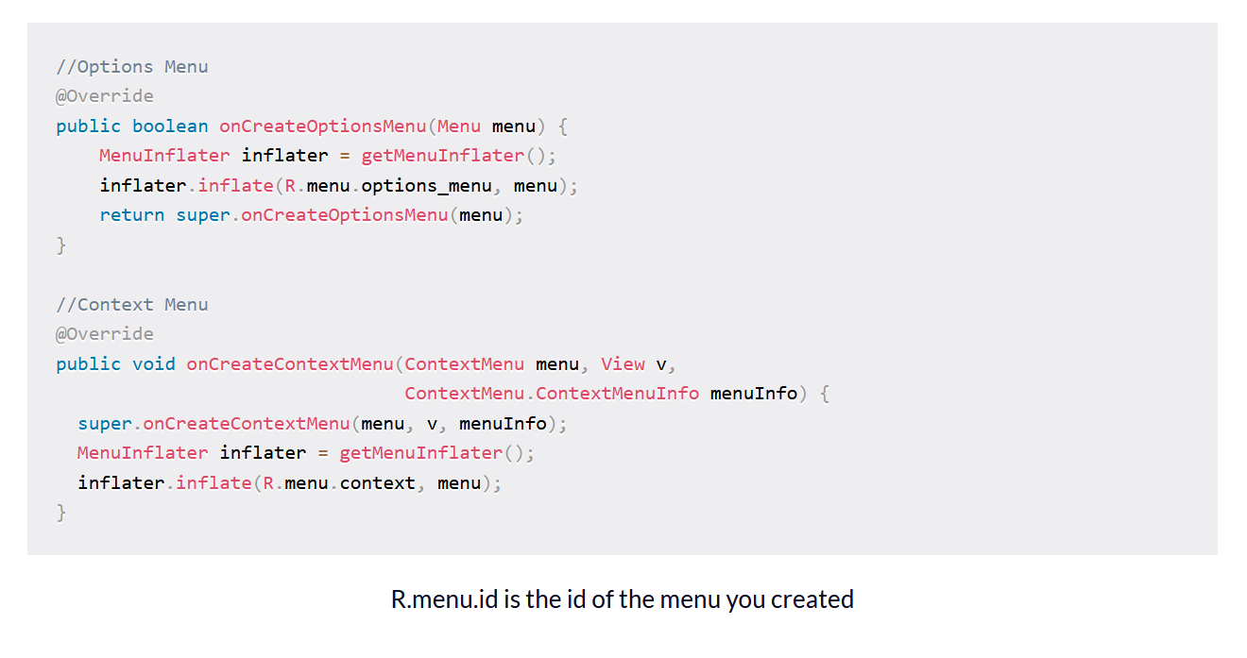
Option Menu
This menu is usually found at the top of your application and in it, you should place actions that affect the application as a whole. These could be the application’s settings or a search box.

Slide 34
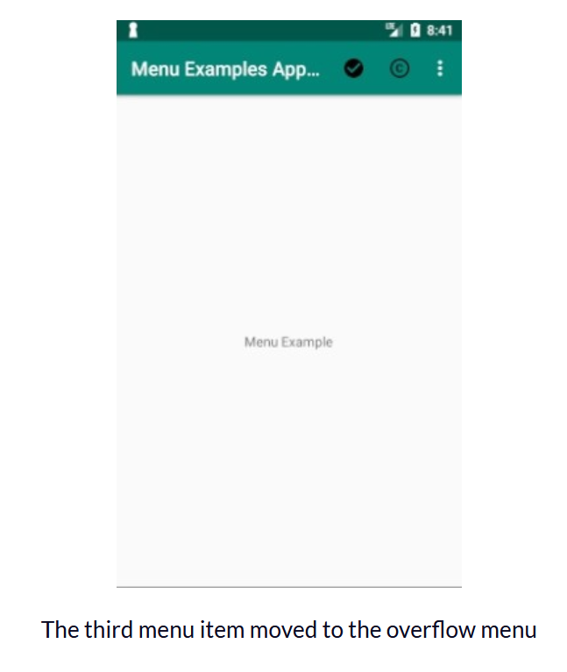
Option Menu
let’s go over the values that can be given for the showAsAction attribute:
always - will always show in the action bar
never - will never show, and therefore will be available through the overflow menu
ifRoom - only if there is sufficient space in the action bar, then it would be shown. Keep in mind that per the documentation, there is a limit to how many icons you can have on the action bar.
withText-will include the item’s title in the action bar
collapseActionView - if this item has an action view associated with it, it will become collapsible(from API 14 and above)
If we go ahead and change the last item in our menu to showAsAction=”never”, we get the following:

Slide 35
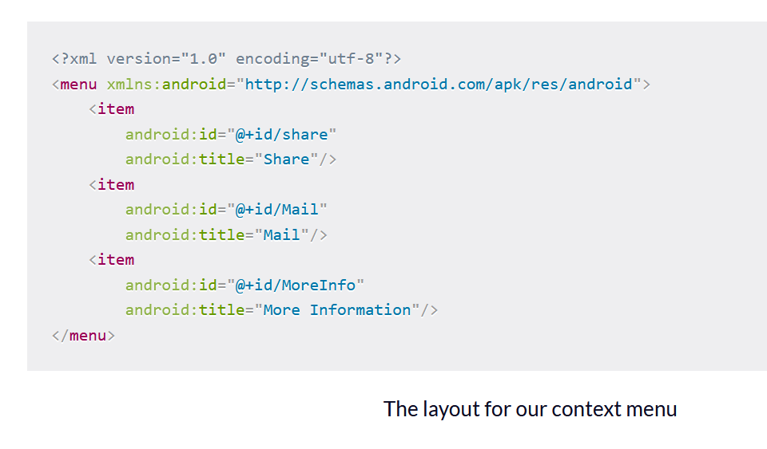
Contextual Menu
This menu appears when a user performs a long click on one of your UI elements. The options found in this menu affect what UI element the user made the click on. It is common to use this type of menu in list or grid views, where the user’s interaction with each item can lead to a specific action.
Imagine a scenario where you have an application with an image, and you want to present to the user several choices when they click on the image.
A context menu can appear in two ways :
1. A floating menu
2. An action bar at the top of your application

Slide 36
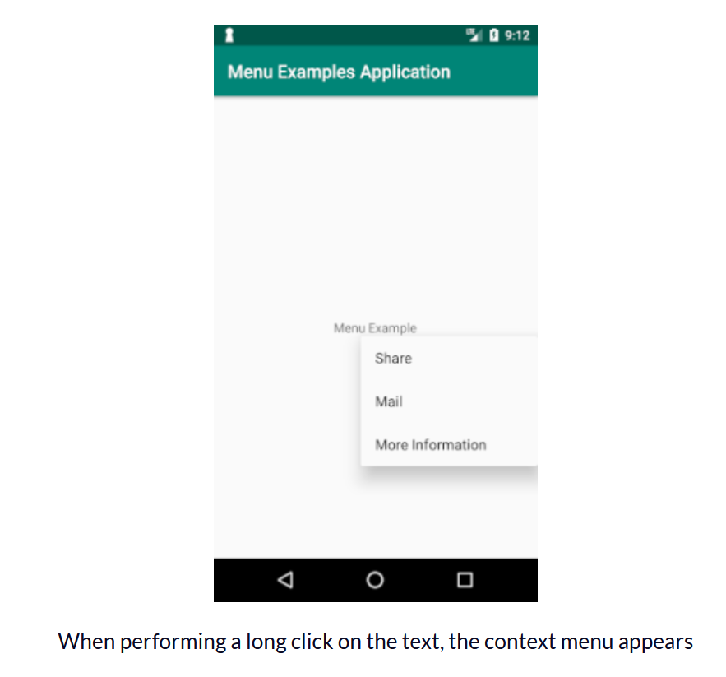

Contextual Menu
And adding the following code to our main activity:

Slide 37


Popup Menu
A popup menu is a type of menu that displays items in a vertical list. This list is attached to the view the user has clicked on to invoke this menu. It is important to keep in mind, that when choosing a popup menu, you do not want the user’s choice to affect the previous content the user pressed.
We will use the same menu XML layout as before, but we will need to add the following code to our activity:
We will get the same result as the previous contextual Menu, but without the need for the user to perform a long click.

Slide 38

Dialog in Android
A dialog is a small window that prompts the user to make a decision or enter additional information. A dialog does not fill the screen and is normally used for events that require users to take an action before they can proceed.
In android, you can create following types of Dialogs:
1. Alert Dialog
2. DatePicker Dialog
3. TimePicker Dialog
4. Custom Dialog

Slide 39


Alert Dialog
This Dialog is used to show a title, buttons(maximum 3 buttons allowed), a list of selectable items, or a custom layout.

Slide 40

DatePicker Dialog
This dialog provides us with a pre-defined UI that allows the user to select a date.

Slide 41

TimePicker Dialog
This dialog provides us with a pre-defined UI that allows the user to select suitable time.

Slide 42

Custom Dialog
You can create your own custom dialog with custom characteristics.

